Slide 1
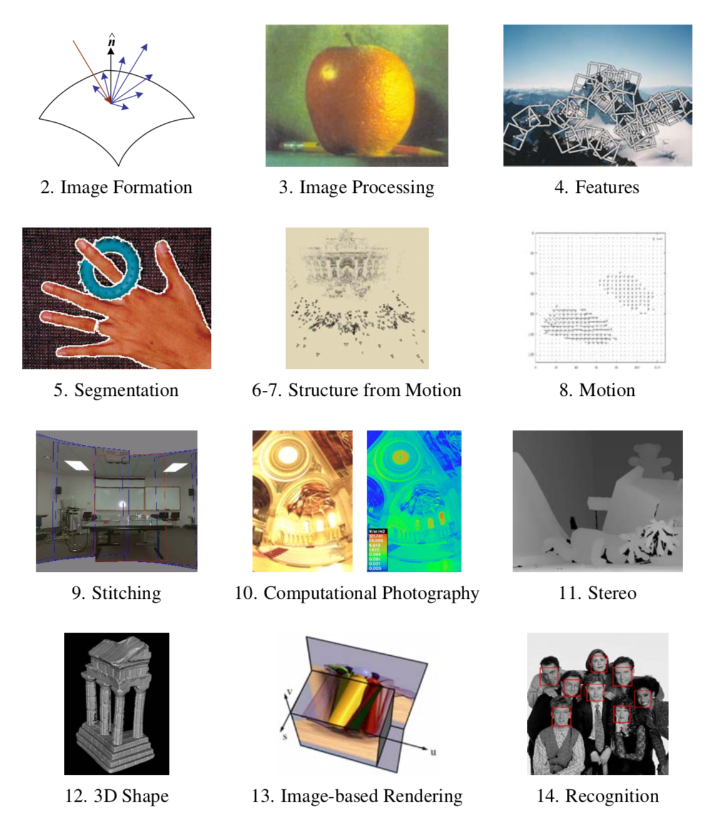

Slide 2
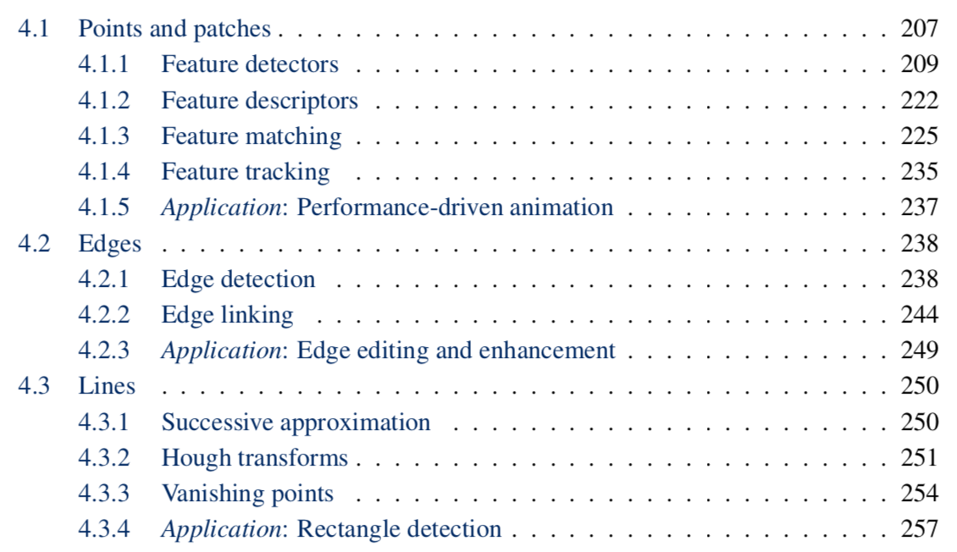

Slide 4
Descriptors

Slide 5

Local features: main components
Detection: Identify the interest points
Description: Extract vector feature descriptor surrounding each interest point.
Matching: Determine correspondence between descriptors in two views
Kristen Grauman

Slide 6

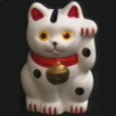
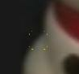
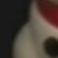
Overview of Keypoint Matching
1. Find a set of distinctive key- points
A₁
B₃
2. Define a region around each keypoint
A₂
A₃
B₁
B₂
3. Compute a local descriptor from the normalized region
4. Match local descriptors

Slide 7
Goals for interest points
Detect points that are repeatable and distinctive

Slide 8
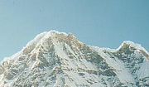
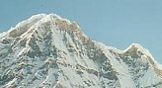
Goal for descriptors: distinctiveness
We want to be able to reliably determine which point goes with which.
Must provide some invariance to geometric and photometric differences between the two views.
?
Kristen Grauman

Slide 9
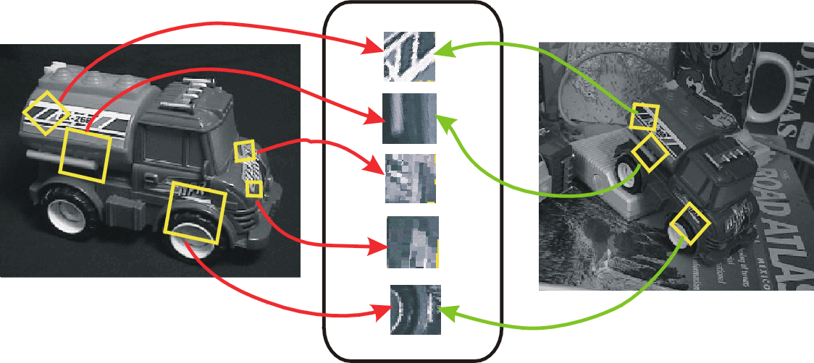
Invariant Local Features
Image content is transformed into local feature coordinates that are invariant to translation, rotation, scale, and other imaging parameters
Feature Descriptors

Slide 10
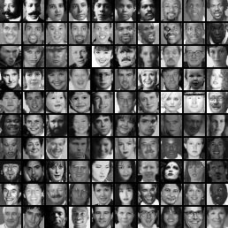
Image representations
Templates
Intensity, gradients, etc.
Histograms
Color, texture, SIFT descriptors, etc.

Slide 11
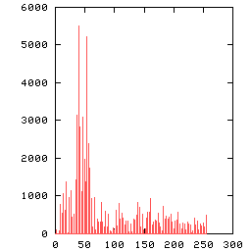
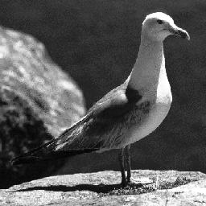
Image Representations: Histograms
Global histogram
Represent distribution of features
Color, texture, depth, …
Space Shuttle Cargo Bay
Images from Dave Kauchak

Slide 12
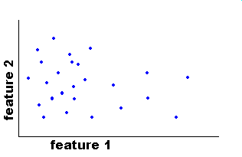
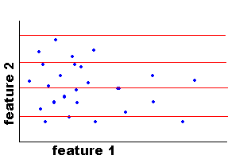
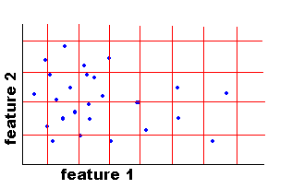
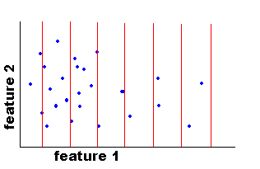
Image Representations: Histograms
Histogram: Probability or count of data in each bin
Joint histogram
Requires lots of data
Loss of resolution to avoid empty bins
Marginal histogram
Requires independent features
More data/bin than joint histogram
Images from Dave Kauchak

Slide 13
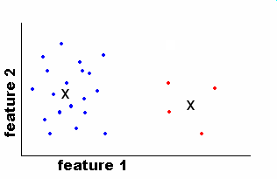
Image Representations: Histograms
Clustering
EASE Truss Assembly
Use the same cluster centers for all images
Space Shuttle Cargo Bay
Images from Dave Kauchak

Slide 14
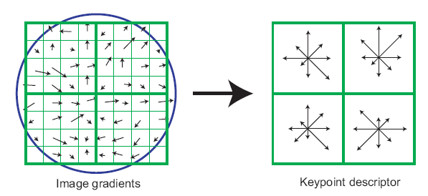
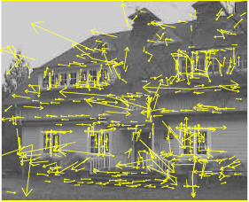
What kind of things do we compute histograms of?
Histograms of oriented gradients
SIFT – Lowe IJCV 2004

Slide 15

SIFT vector formation
Computed on rotated and scaled version of window according to computed orientation & scale
resample the window
Based on gradients weighted by a Gaussian of variance half the window (for smooth falloff)

Slide 16
SIFT vector formation
4x4 array of gradient orientation histogram weighted by magnitude
8 orientations x 4x4 array = 128 dimensions
Motivation: some sensitivity to spatial layout, but not too much.
showing only 2x2 here but is 4x4

Slide 17
Ensure smoothness
Gaussian weight
Interpolation
a given gradient contributes to 8 bins: 4 in space times 2 in orientation

Slide 18
Reduce effect of illumination
128-dim vector normalized to 1
Threshold gradient magnitudes to avoid excessive influence of high gradients
after normalization, clamp gradients >0.2
renormalize

Slide 19
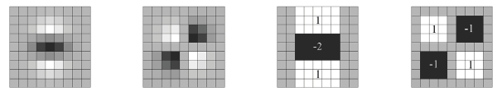
Local Descriptors: SURF
Fast approximation of SIFT idea
Efficient computation by 2D box filters & integral images ⇒ 6 times faster than SIFT
Equivalent quality for object identification
GPU implementation available
Feature extraction @ 200Hz (detector + descriptor, 640×480 img)
http://www.vision.ee.ethz.ch/~surf
[Bay, ECCV’06], [Cornelis, CVGPU’08]

Slide 20
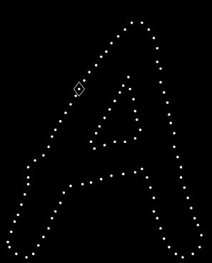
Local Descriptors: Shape Context
Count the number of points inside each bin, e.g.:
Count = 4
...
Count = 10
Log-polar binning: more precision for nearby points, more flexibility for farther points.
Belongie & Malik, ICCV 2001
K. Grauman, B. Leibe

Slide 21
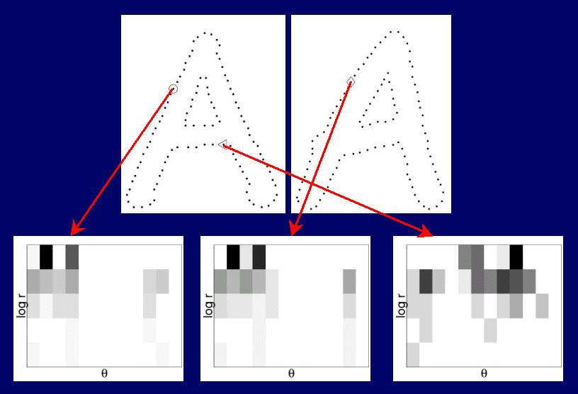
Shape Context Descriptor

Slide 22
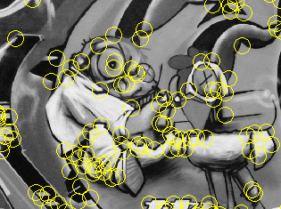
Things to remember
Keypoint detection: repeatable and distinctive
Corners, blobs, stable regions
Harris, DoG
Descriptors: robust and selective
spatial histograms of orientation
SIFT

Slide 23
Deep Descriptors

Slide 24
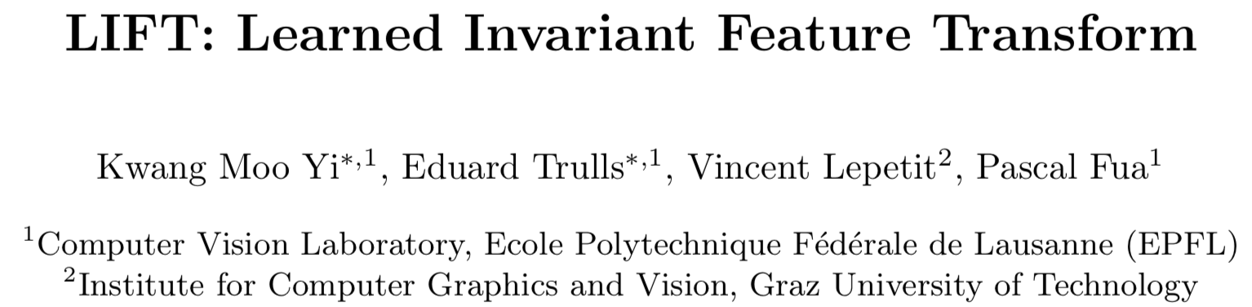
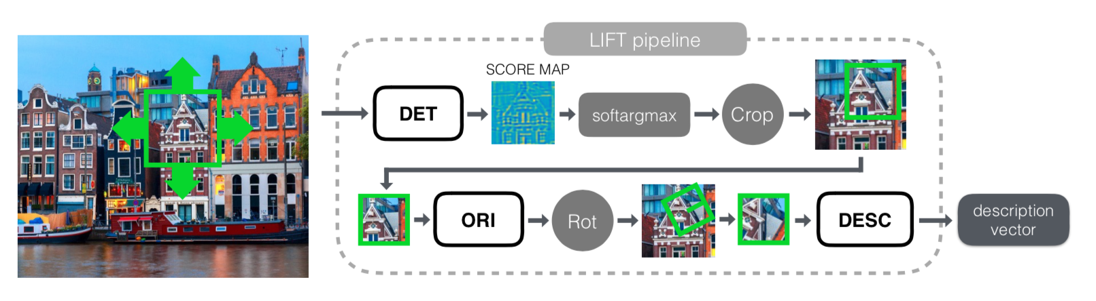
ECCV 2016
Three networks: detection, orientation, description
detection+orientation -> STN -> descriptor
Trained separately :-(

Slide 25
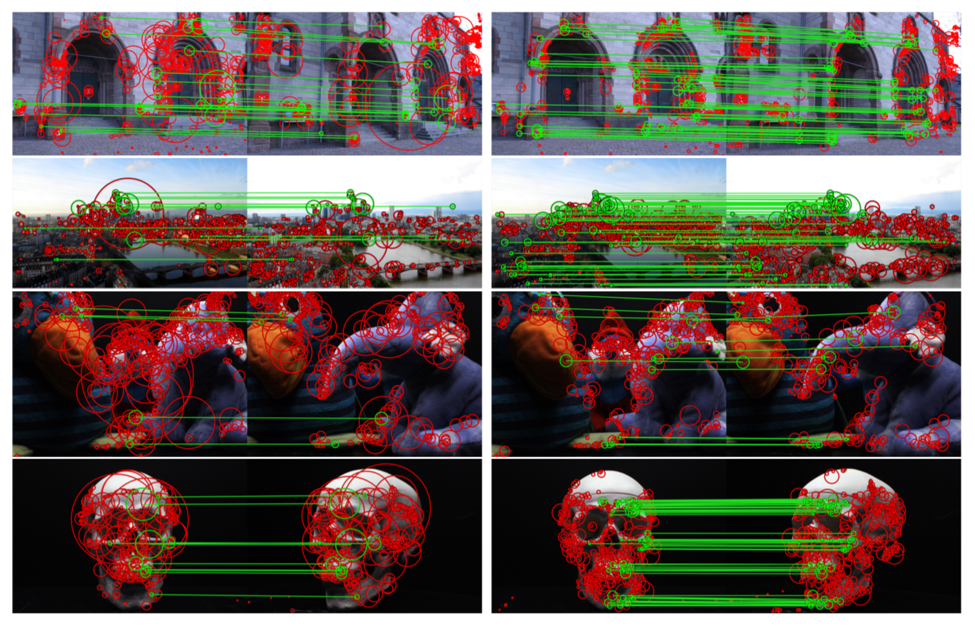
SIFT vs. LIFT

Slide 26
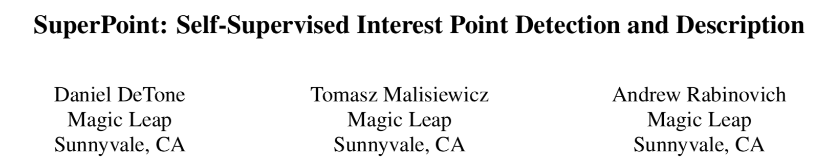
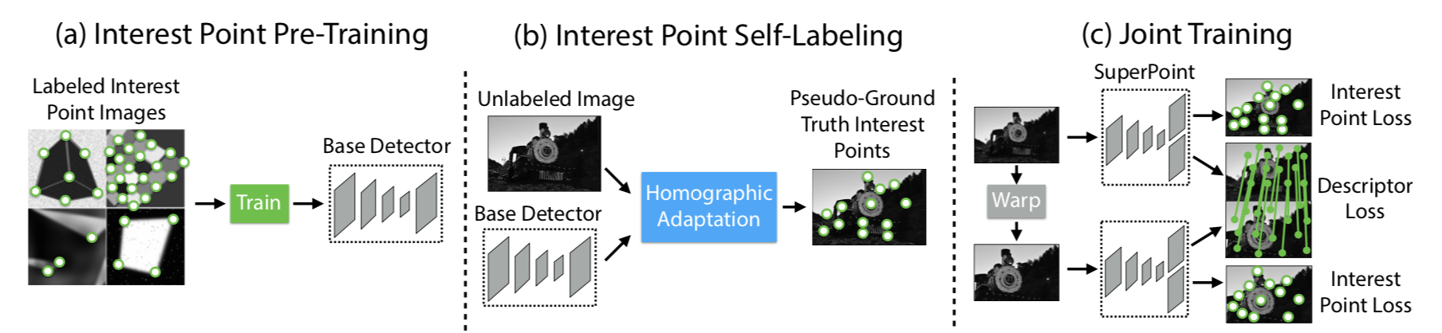
2018 CVPR Workshop
Interest point = ill-defined -> self-supervised
MagicPoint -> SuperPoint

Slide 27
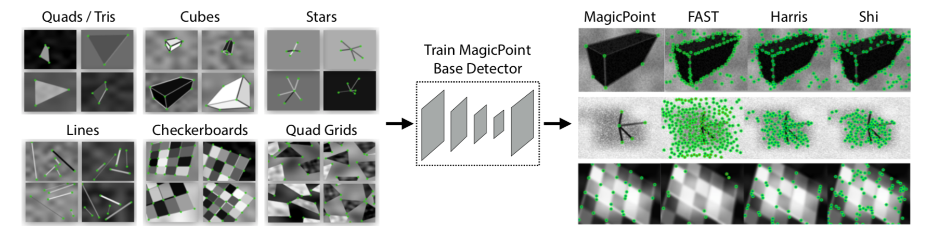
MagicPoint

Slide 28
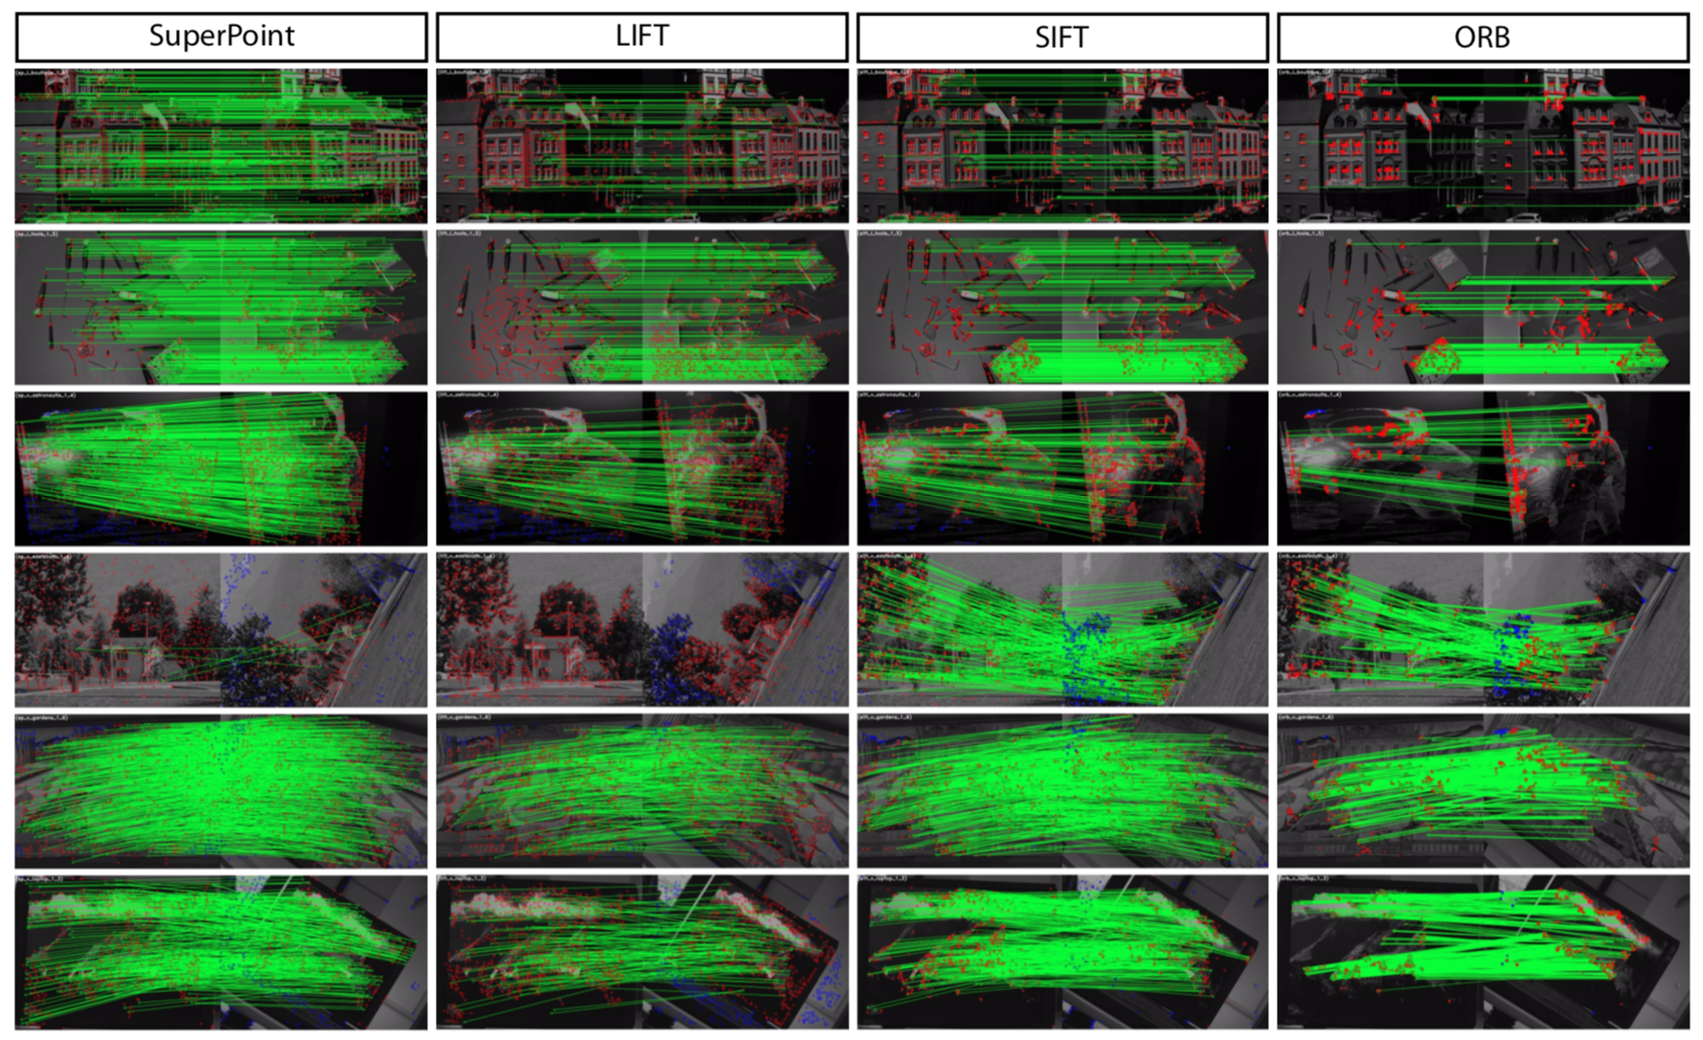
SuperPoint Results

Slide 29
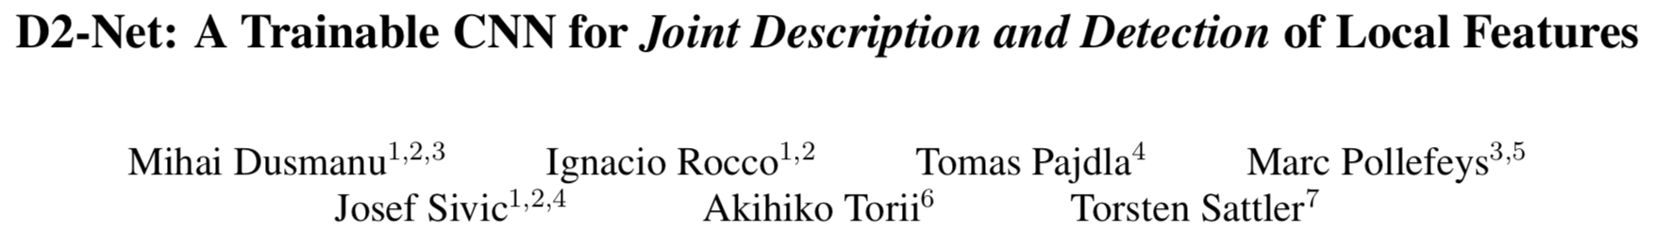
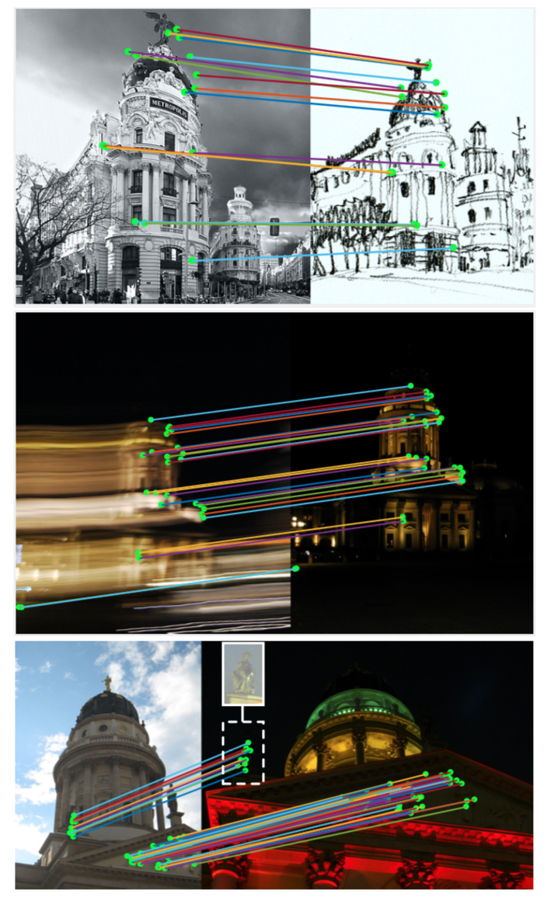
CVPR 2019
Tensor viewed as descriptors and detector maps
VGG16-based, loss encourages distinctiveness and repeatability
Results beat the star of the art in day-night and indoor localization, but not in more traditional settings (Superpoint shines for HPatches, GeoDesc for SFM)

Slide 30
Matching

Slide 31
Local features: main components
Detection: Identify the interest points
Description: Extract vector feature descriptor surrounding each interest point.
Matching: Determine correspondence between descriptors in two views
Kristen Grauman

Slide 32
Matching
Simplest approach: Pick the nearest neighbor. Threshold on absolute distance
Problem: Lots of self similarity in many photos

Slide 33
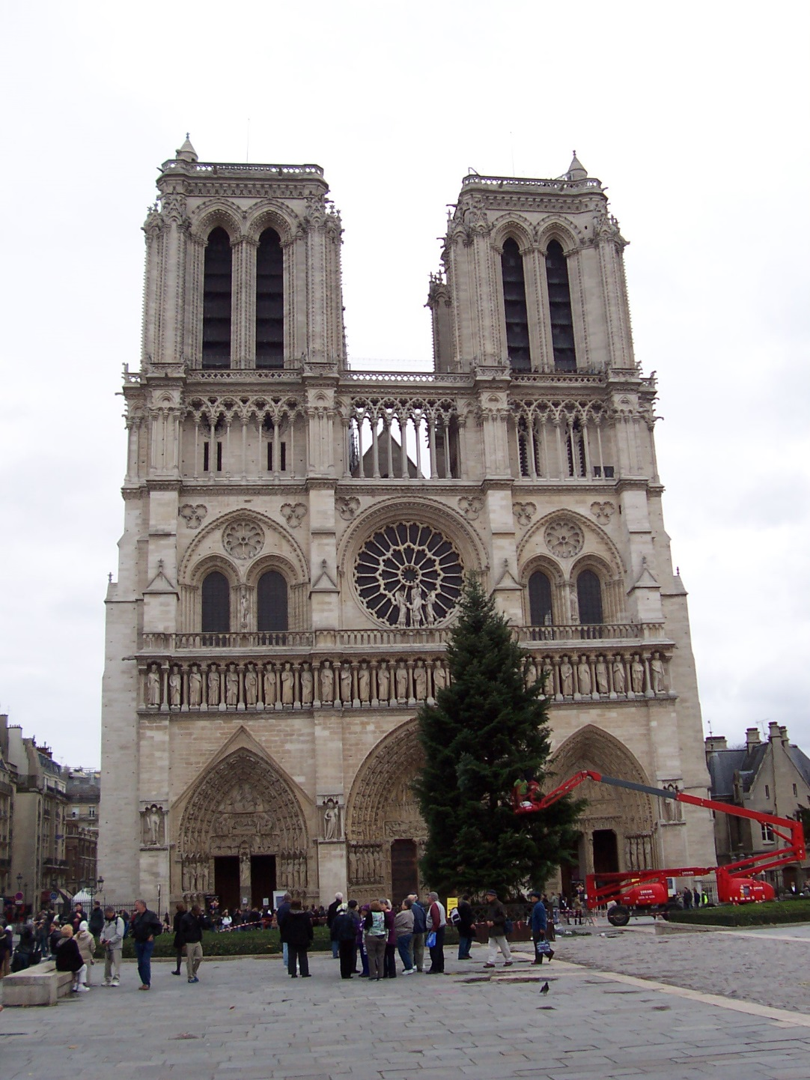
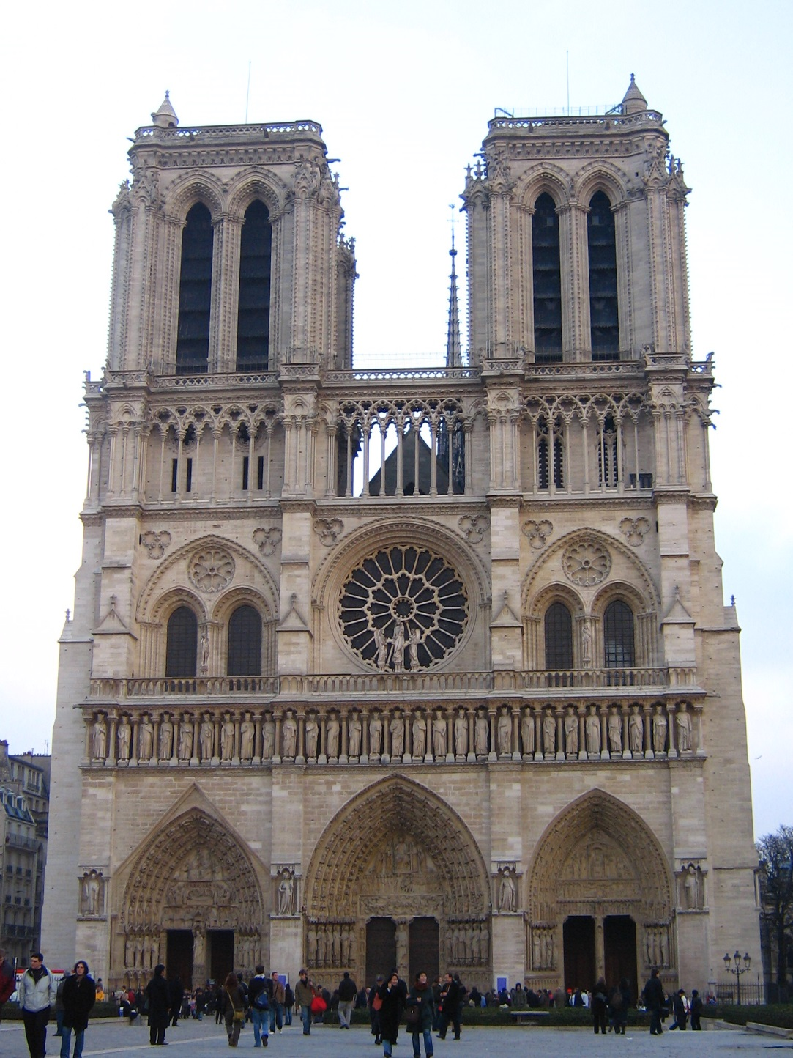
Distance: 0.34, 0.30, 0.40 Distance: 0.61
Distance: 1.22

Slide 34
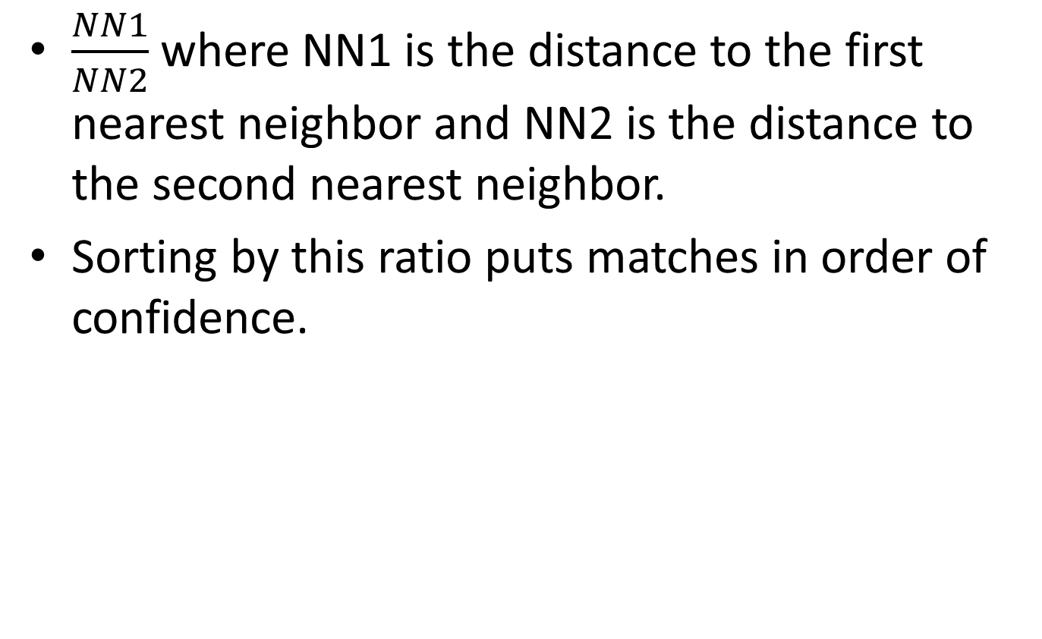
Nearest Neighbor Distance Ratio
$\frac{NN1}{NN2}$ where NN1 is the distance to the first nearest neighbor and NN2 is the distance to the second nearest neighbor.
Sorting by this ratio puts matches in order of confidence.

Slide 35
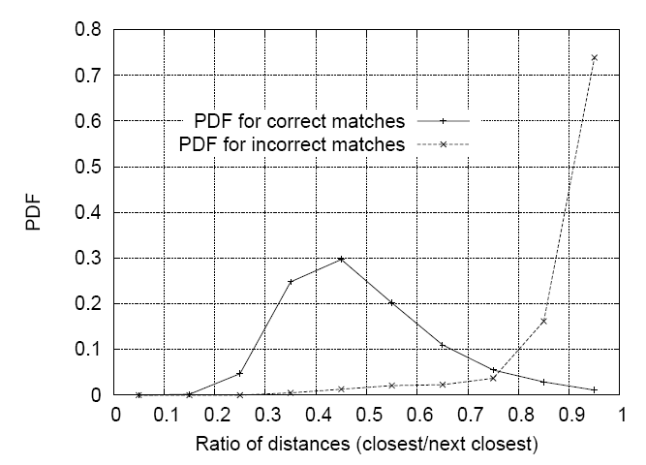
Matching Local Features
Nearest neighbor (Euclidean distance)
Threshold ratio of nearest to 2nd nearest descriptor
Lowe IJCV 2004

Slide 36
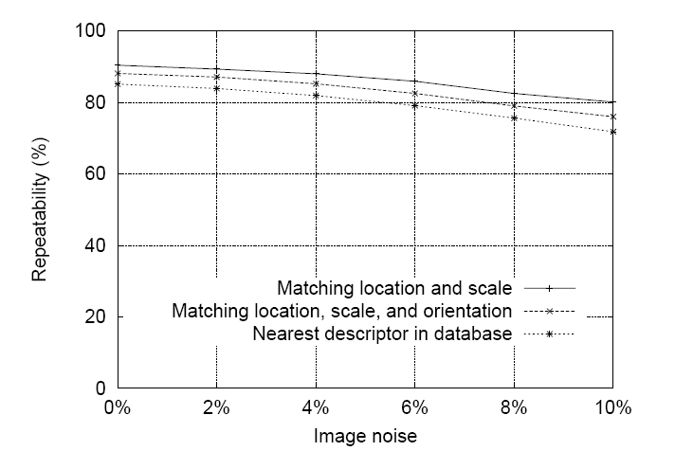
SIFT Repeatability
Lowe IJCV 2004

Slide 37
SIFT Repeatability

